Slide 1





FINAL PROJECT
CRYPTO CURRENCY
BY NGUYEN VAN DONG

Slide 2

CONTENT
01
02
03
04
05
Goals
Data Modeling
SQL Query Steps
Power BI Visualization
Experiences &
Conclusions

Slide 3





GOALS
Problem Statement
Data Modeling
Working with Data
Sharing the results
Understand business model
Determine stakeholders
Defining objectives
Selecting tools and metrics
Understand data dictionary
Determine tables and keys
Selecting tools and making data modeling
Collecting data
Data cleaning and normalizing
Data exploring and analyzing
Making data visualization
Showing results and conclusions

Slide 4

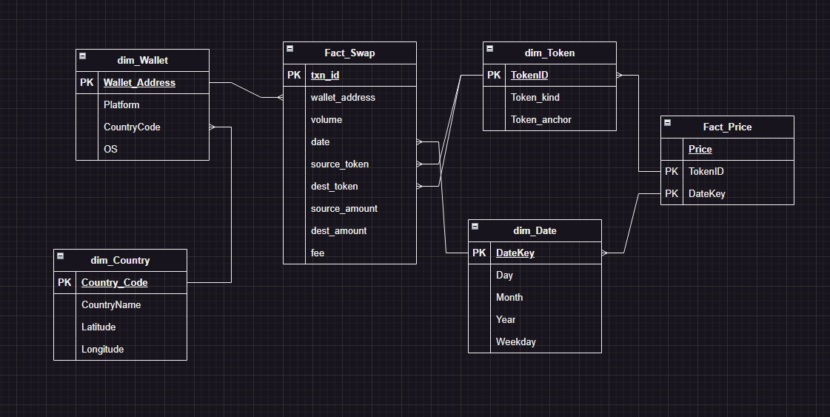

DATA MODELING
Data modeling organizes and structures data, enabling efficient analysis and decision-making while improving data management and communication.

Slide 5

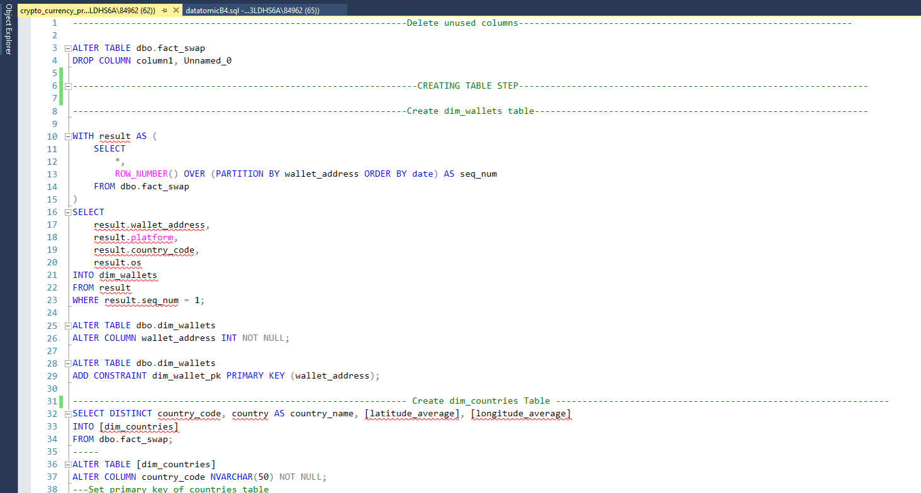
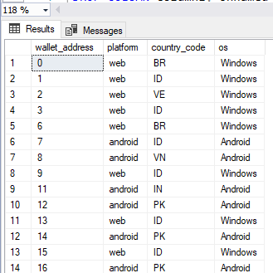

SQL QUERY STEPS
CREATING TABLES

Slide 6
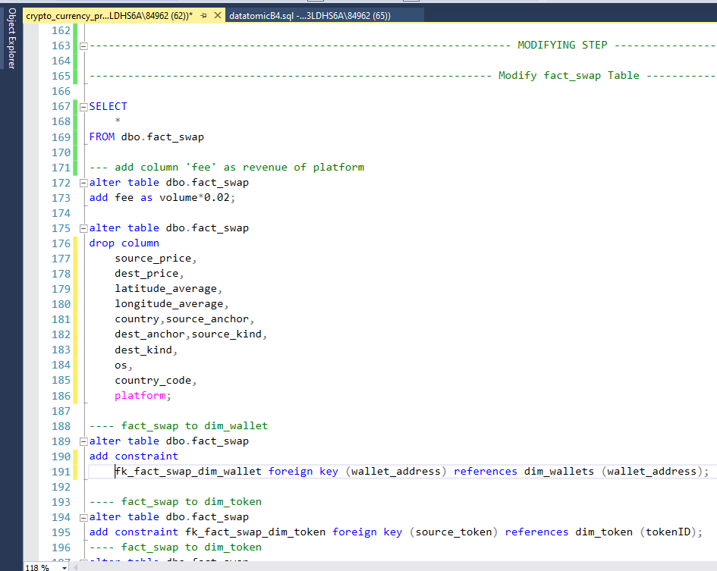
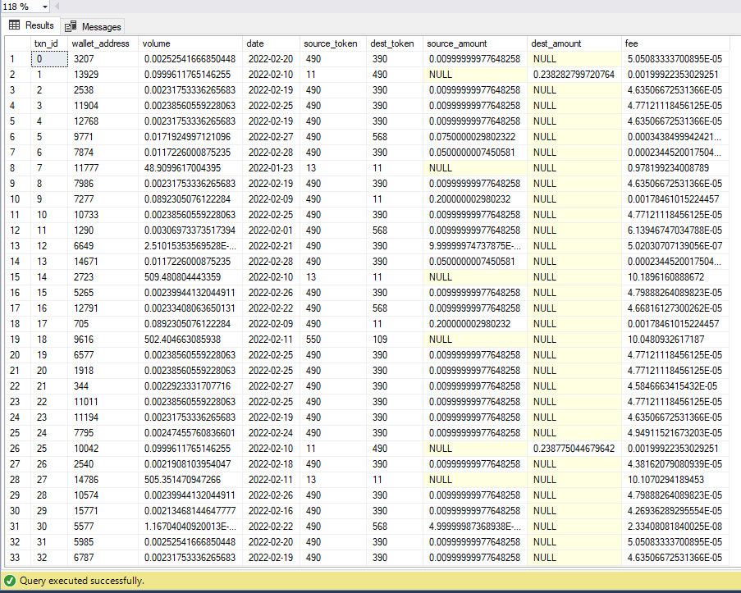
SQL QUERY STEPS
MODIFYING TABLES

Slide 7
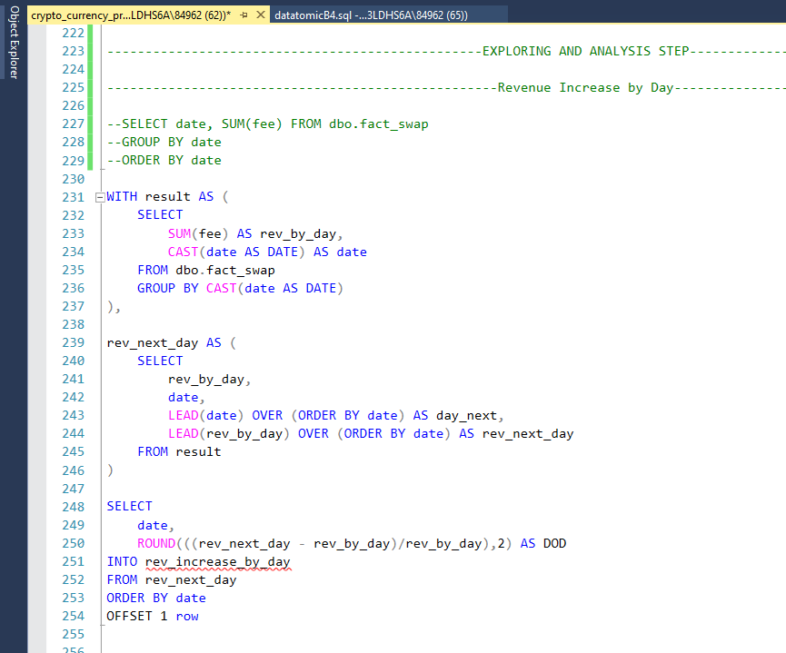
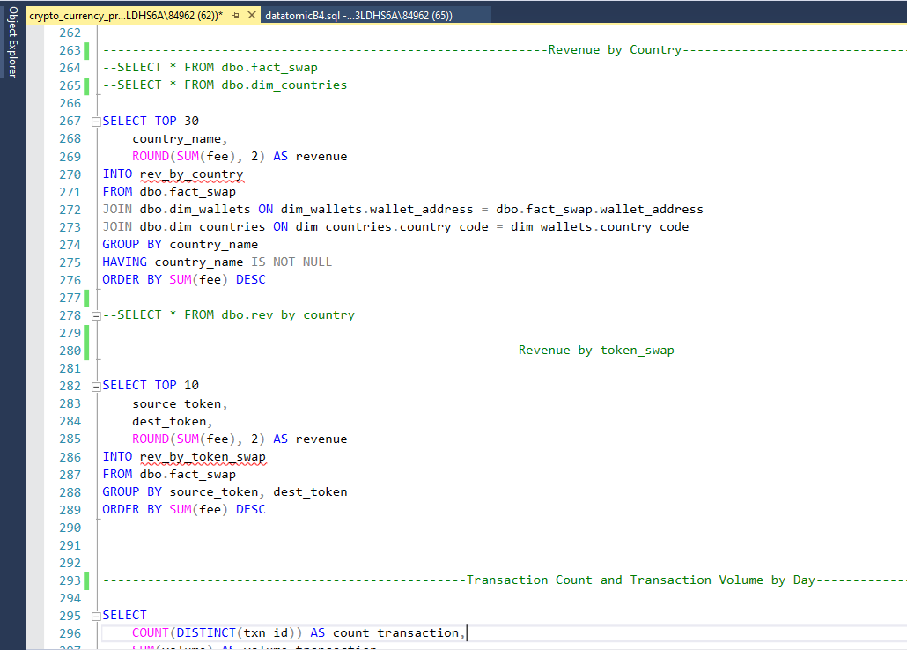
SQL QUERY STEPS
EXPLORING AND ANALYZING STEPS

Slide 8
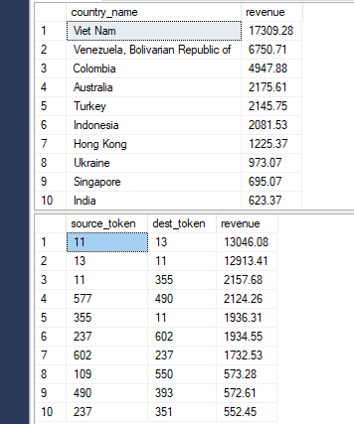
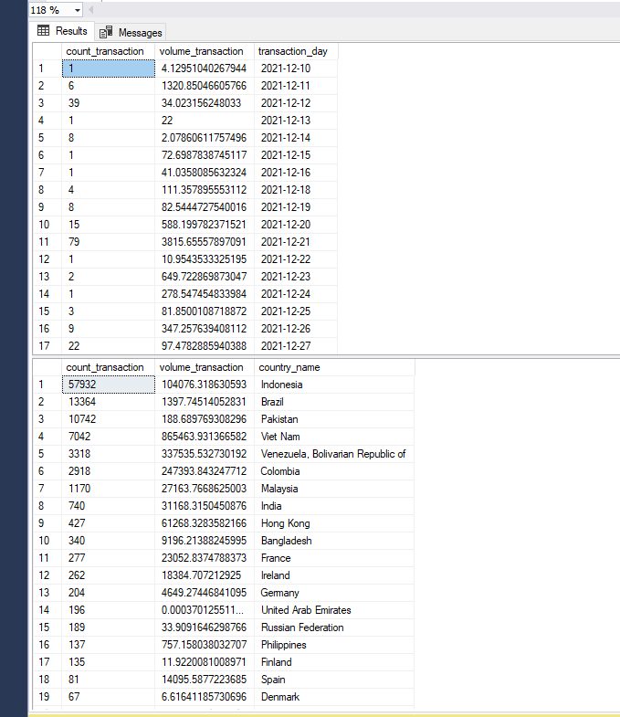
SQL QUERY STEPS
EXPLORING AND ANALYZING STEPS

Slide 9

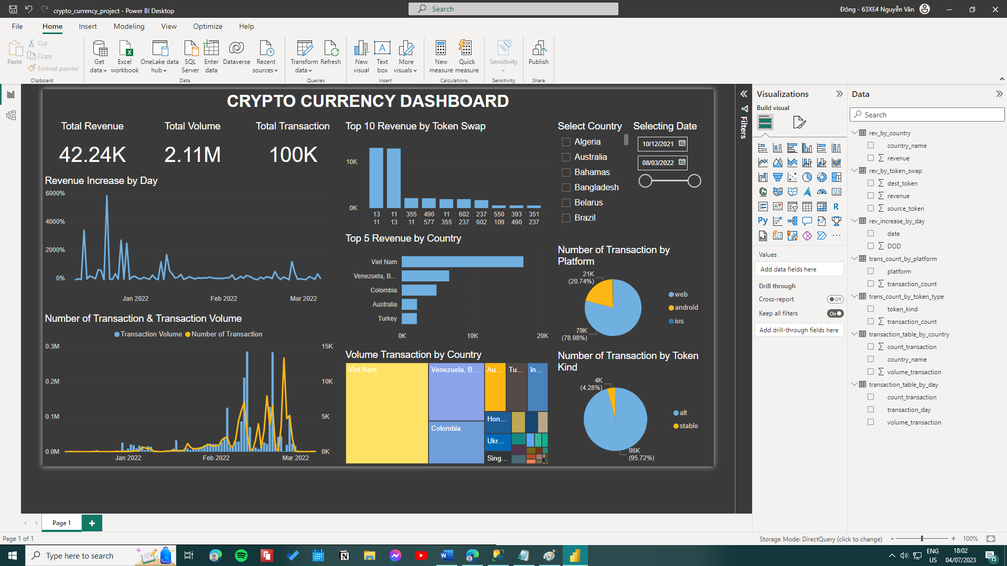
POWER BI VISUALIZATION

Slide 10
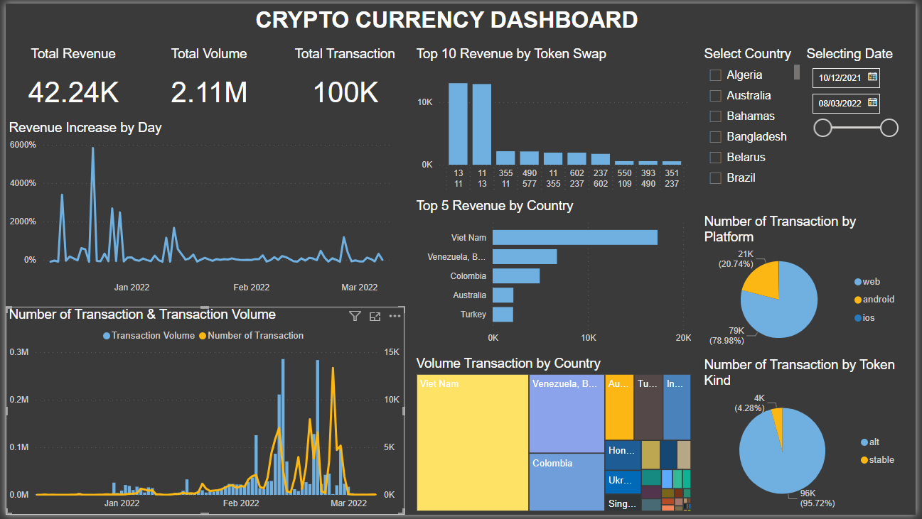
CONCLUSIONS
01
The number of transactions and its volume has increased at the beginning of the year 2022.
02
11-13/13-11 is the preferred token pair in trading transactions, generating a much larger revenue than other pairs.

Slide 11
CONCLUSIONS
03
Although the transaction volume in Vietnam is not in the top of the countries, the transactions coming from here generate much larger revenue than other countries.
04
Users prefer to transact on computers than on mobile phones based on Number of Transactions by Platform chart.
05
The majority of traders trade alt tokens, which can be explained because token 13 is pegged to the USD and it is one of the most traded coins. We can conclude that token holders tend to be risk averse.

Slide 12
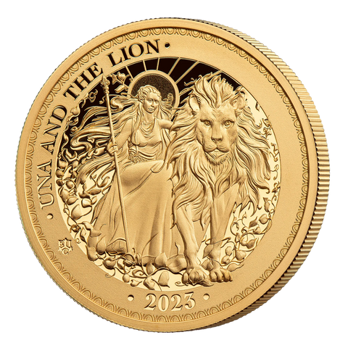






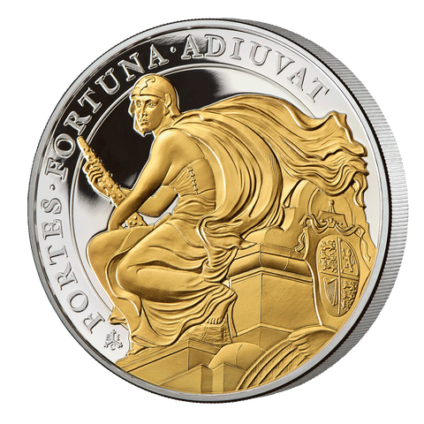

THANKS FOR LISTENING

